Slide 1
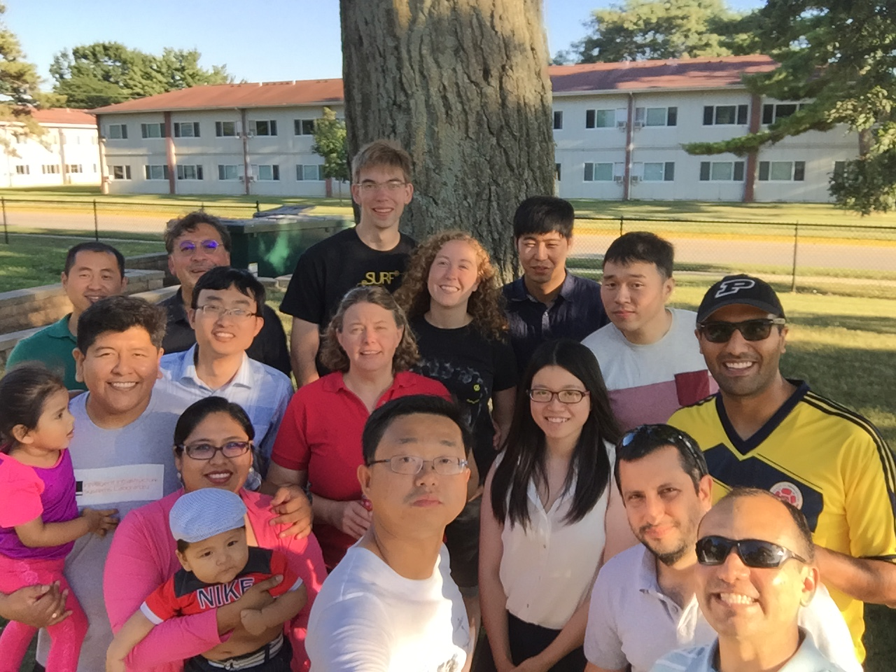
Graduation Party for Gaby [Ge] Ou (Summer 2016)

